Slide 1
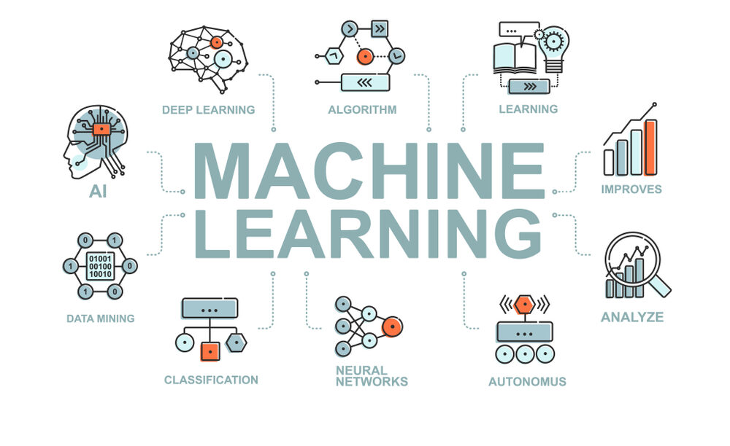

Slide 2
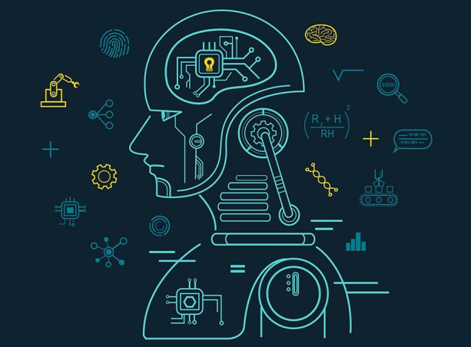
Machine Learning
Machine learning (ML) is a discipline of artificial intelligence (AI) that provides machines with the ability to automatically learn from data and past experiences while identifying patterns to make predictions with minimal human intervention.

Slide 3
Machine learning is a method of training a machine to learn from data, rather than being explicitly programmed. It involves feeding a machine a large dataset and allowing it to learn and improve performance over time.

Slide 4
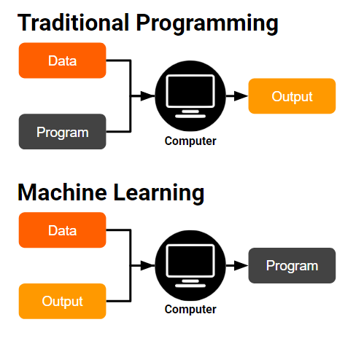

Slide 5
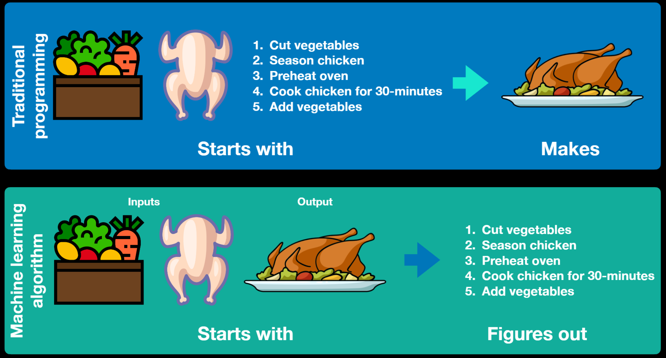

Slide 6
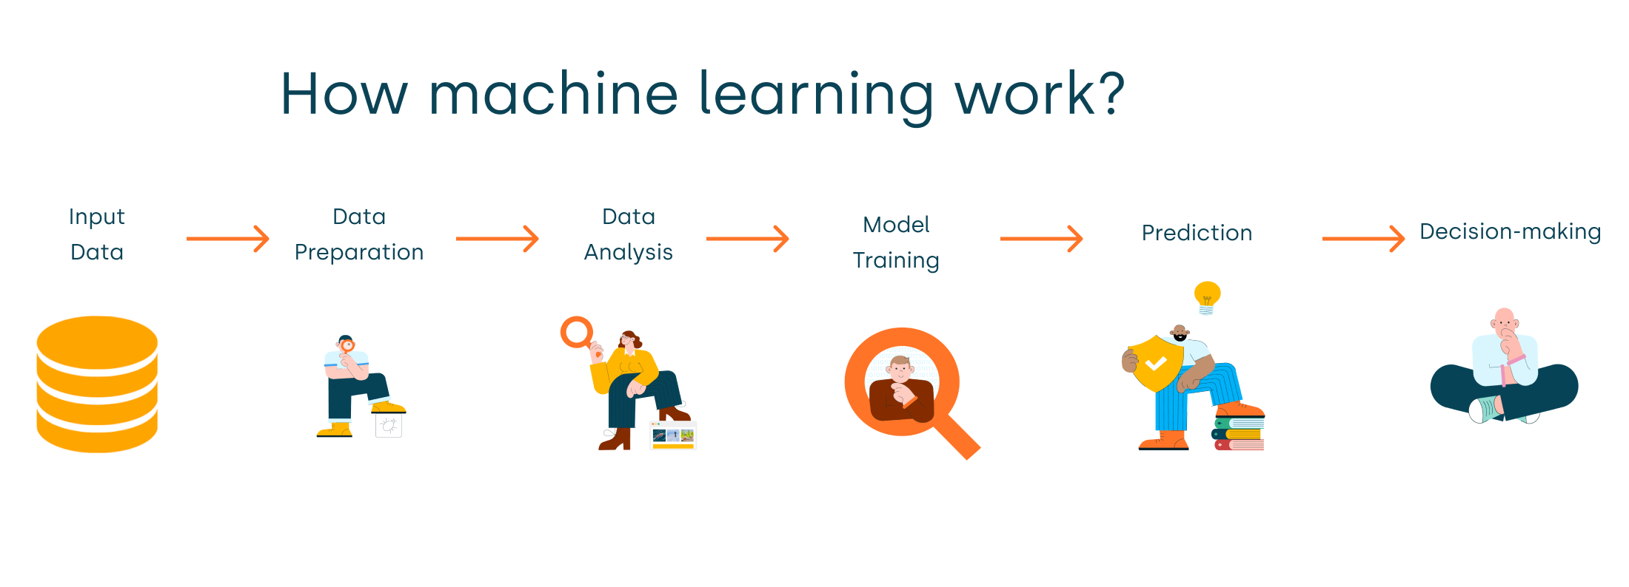

Slide 7
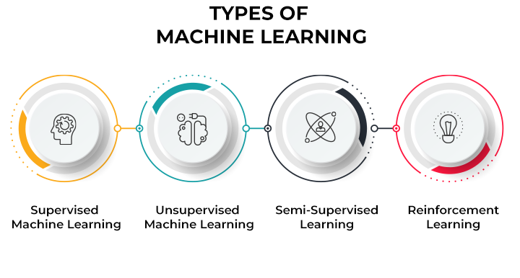

Slide 8
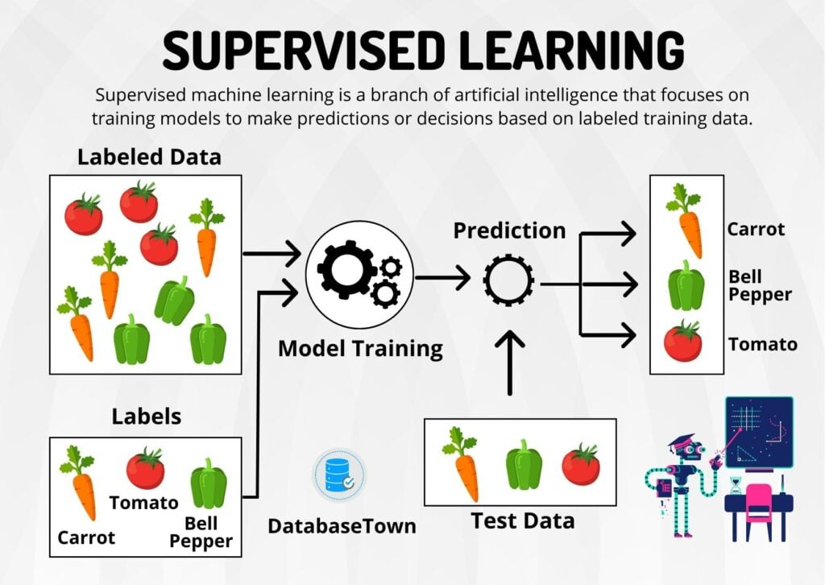

Slide 9
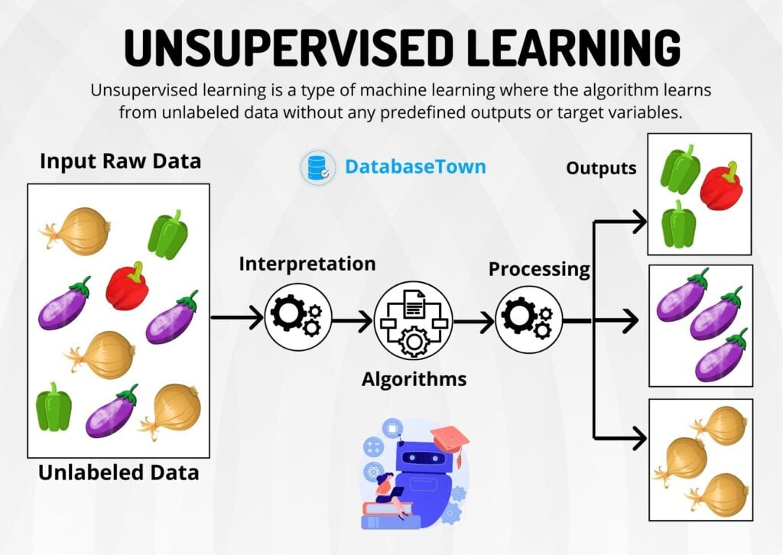

Slide 10
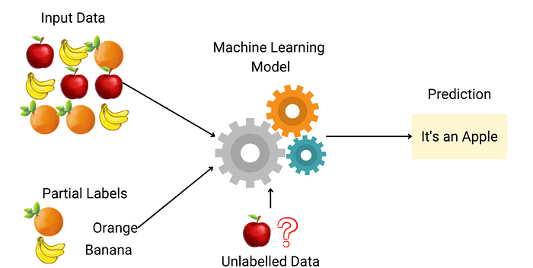
Semi Supervised Learning

Slide 11
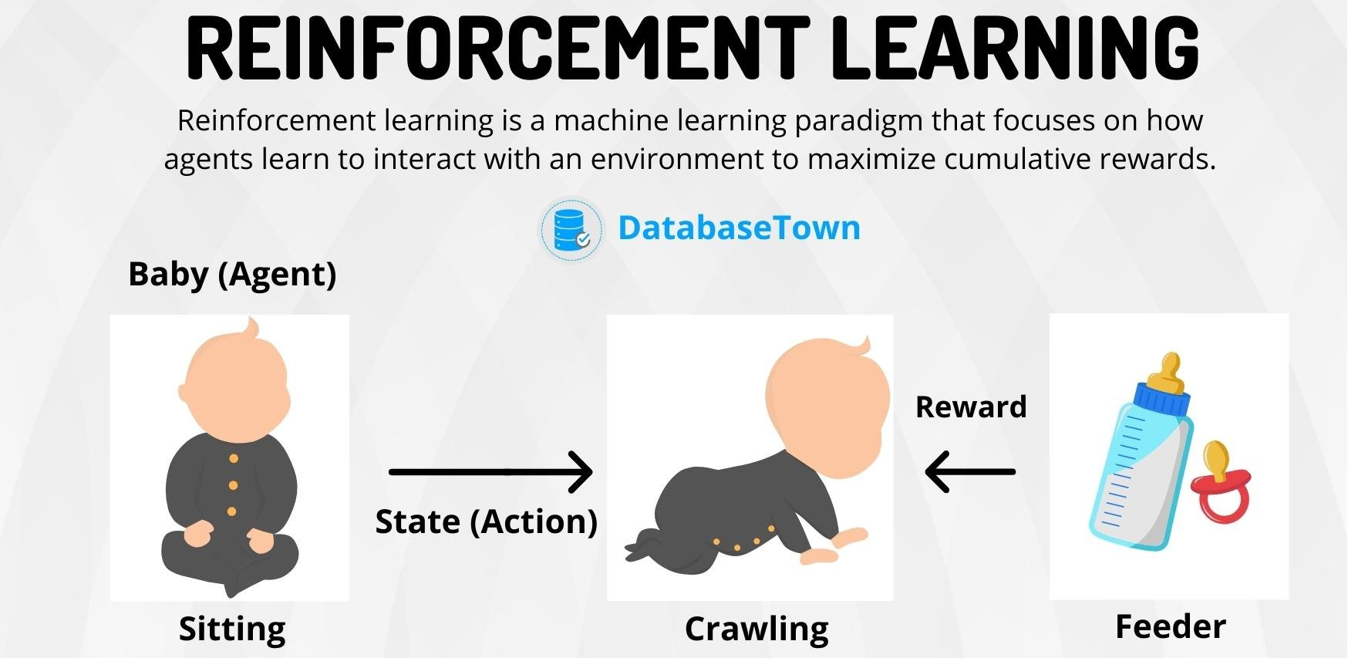

Slide 12
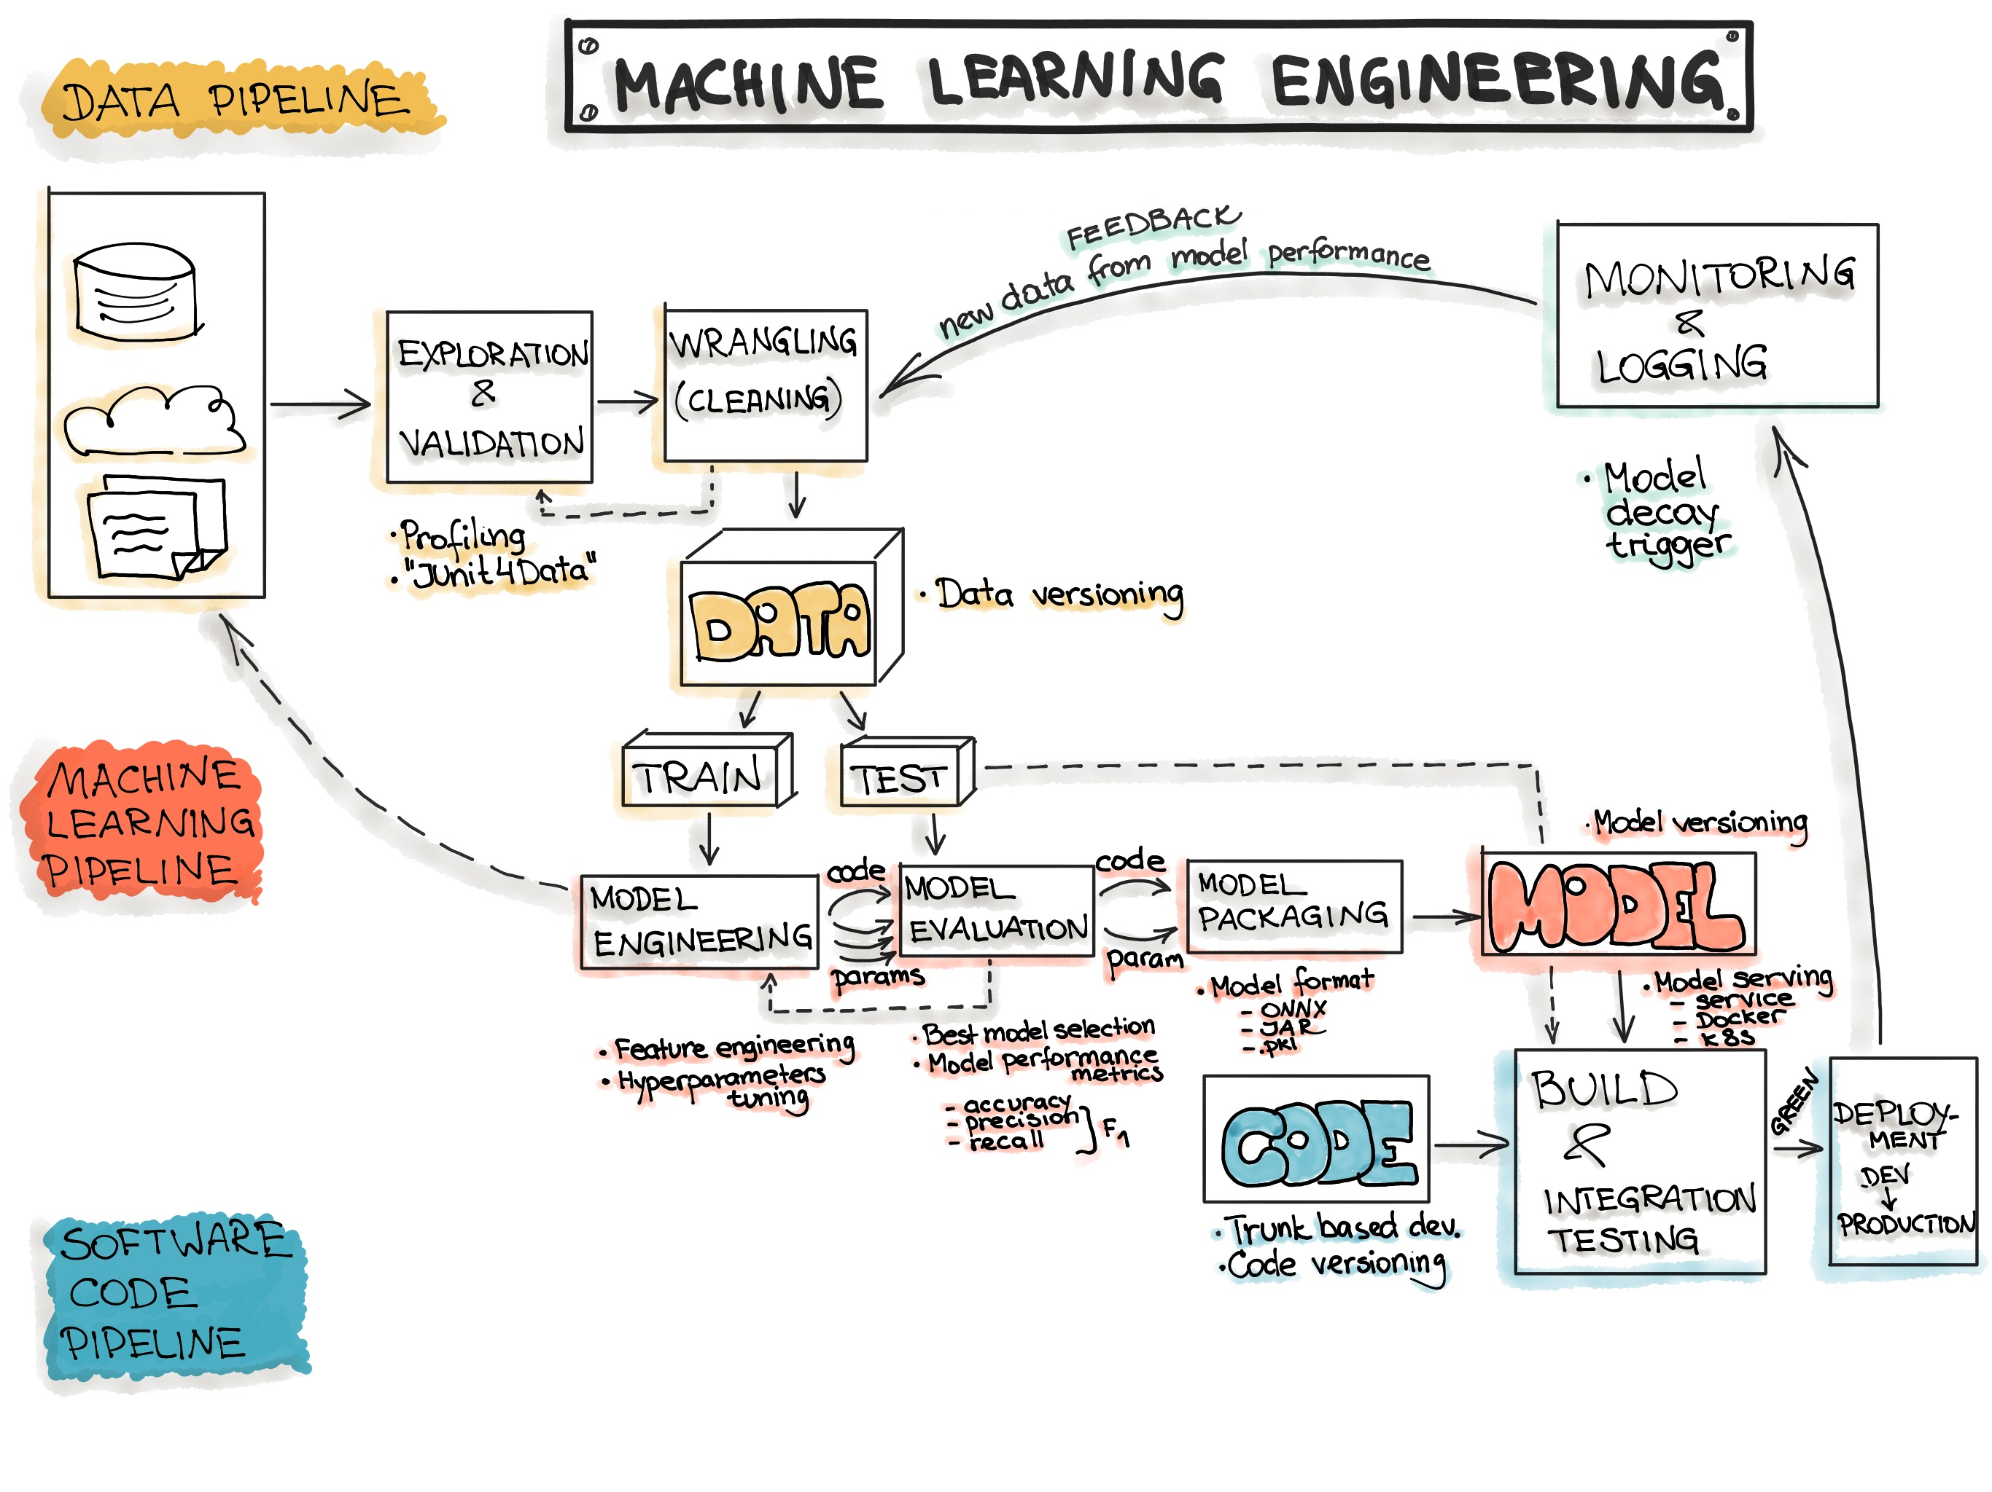
ML Model Building to Deployment | Steps A Z

Slide 13

Underfitting & Overfitting

Slide 14
This story starts with one ‘Student’ 👨🏻‍🎓👩🏻‍🎓 studying for an exam💯.
Underfitting happens — When a student doesn’t study enough so fails to the exam.😭
Overfitting happens — The same student this time memorizes the study material without understanding the concept. And this time he pass the exam but, when a teacher asked outside of the exam paper this student don’t have answers because he memorize the answers in the studying material not understand the concept.

Slide 15
Note🔥:
If the model is doing very well on the training dataset but poorly on the validation set, it means ‘Overfitting’. Here is the example remember,if the training error is 1% and ‘validaton_error’ 10%…
Or the same thing the opposite model performs badly on the training set it’s called ‘Underfitting’. For example if the train_error is 24% and val_error is 25%

